Slide 1
Exploring the Wonders
of India and the World with
“ Aagam Travels”.

Slide 2
Name - Aagam Shah.
Roll no. - M1A4-51.
Enrollment no. - 2204030102532.
Class - B.C.A.
Semester - 2.

Slide 3

Services Offered by Aagam Travels Company:
The Indian travelling company offers a wide range of services to make the travel experience hassle-free and enjoyable. They provide services such as accommodation booking, transportation booking, sightseeing, and more. They also help in planning and organizing trips, providing information on destinations, and arranging for visas and other travel documents.
The company also offers special packages for different types of trips. They provide customized packages for honeymoons, family trips, corporate trips, and more. They also provide discounts for group bookings and special offers for students. Furthermore, they have a team of experienced and knowledgeable professionals who are dedicated to providing the best possible service to their customers.

Slide 4

Destinations Covered by Aagam Travels Company:
The Indian travelling company covers a wide range of destinations in India. From the majestic Himalayas to the lush green tea gardens of Assam, they have something for everyone. They also cover popular destinations such as Goa, Kerala, Rajasthan, and more. They also provide international packages to places such as Thailand, Singapore, and Dubai.
The company also offers special packages for different types of trips. They provide customized packages for honeymoons, family trips, corporate trips, and more. They also provide discounts for group bookings and special offers for students. Furthermore, they have a team of experienced and knowledgeable professionals who are dedicated to providing the best possible service to their customers.

Slide 5

Advantages of Choosing Aagam Travels Company:
There are several advantages of choosing an Indian travelling company. They provide a wide range of services such as accommodation booking, transportation booking, sightseeing, and more. They also help in planning and organizing trips, providing information on destinations, and arranging for visas and other travel documents.
The company also offers special packages for different types of trips. They provide customized packages for honeymoons, family trips, corporate trips, and more. They also provide discounts for group bookings and special offers for students. Furthermore, they have a team of experienced and knowledgeable professionals who are dedicated to providing the best possible service to their customers.

Slide 6

Safety and Security Measures Taken by Aagam Travels Company:
The Indian travelling company takes several safety and security measures to ensure that their customers have a safe and enjoyable experience. They have a team of experienced and knowledgeable professionals who are dedicated to providing the best possible service to their customers. They also have a 24/7 customer care team to provide assistance in case of any emergency.
The company also ensures that the vehicles used for transportation are in good condition and are regularly maintained. They also provide insurance coverage for their customers in case of any unforeseen circumstances. Furthermore, they conduct regular safety audits to ensure that their customers are safe and secure while travelling.

Slide 7

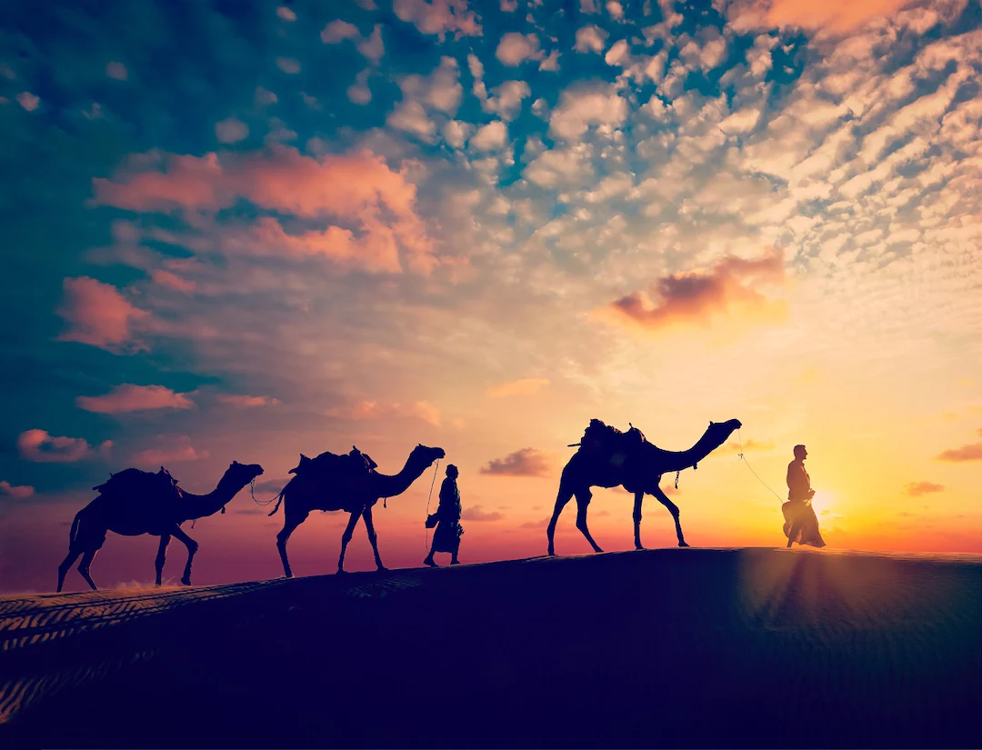
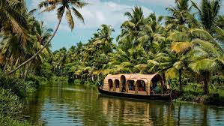
Some of our Domestic tour packages:
Welcome to the land of sun, sand and sea! Goa, India's beach paradise, is waiting for you to explore its vibrant culture, rich history, and breathtaking natural beauty.
We are pleased to offer you a comprehensive tour of Goa that will take you on an exciting journey through the best that this region has to offer.
Welcome to the Land of Kings! Rajasthan, India's largest state, is renowned for its majestic palaces, grand forts, colorful festivals, and rich culture.
We are delighted to offer you a comprehensive tour of Rajasthan that will take you on an exciting journey through the best that this region has to offer.
Welcome to God's Own Country! Kerala, India's tropical paradise, is known for its palm-lined beaches, tranquil backwaters, lush greenery, and unique culture.
We are excited to offer you a comprehensive tour of Kerala that will take you on an enchanting journey through the best that this region has to offer.

Slide 8

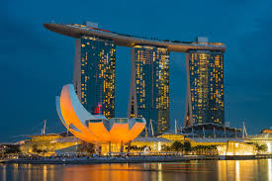

Some of our international tour packages:
Welcome to the Land of Smiles! Thailand, with its vibrant culture, breathtaking landscapes, and world-class cuisine, is a must-visit destination for any traveler.
We are thrilled to offer you a comprehensive tour of Thailand that will take you on an exciting journey through the best that this country has to offer.
Welcome to the City of Gold! Dubai, with its towering skyscrapers, luxurious shopping, and fascinating blend of modern and traditional culture, is a must-visit destination for any traveler.
We are thrilled to offer you a comprehensive tour of Dubai that will take you on an exciting journey through the best that this city has to offer.
Welcome to the Lion City! Singapore, with its futuristic cityscape, diverse culture, and world-renowned cuisine, is a must-visit destination for any traveler.
We are excited to offer you a comprehensive tour of Singapore that will take you on an unforgettable journey through the best that this island city-state has to offer.

Slide 9
Thank you.

